Slide 1


Objectives
In this session, you will learn to:
Advanced properties of CSS
Properties of CSS3
Designing layout of website

Slide 2
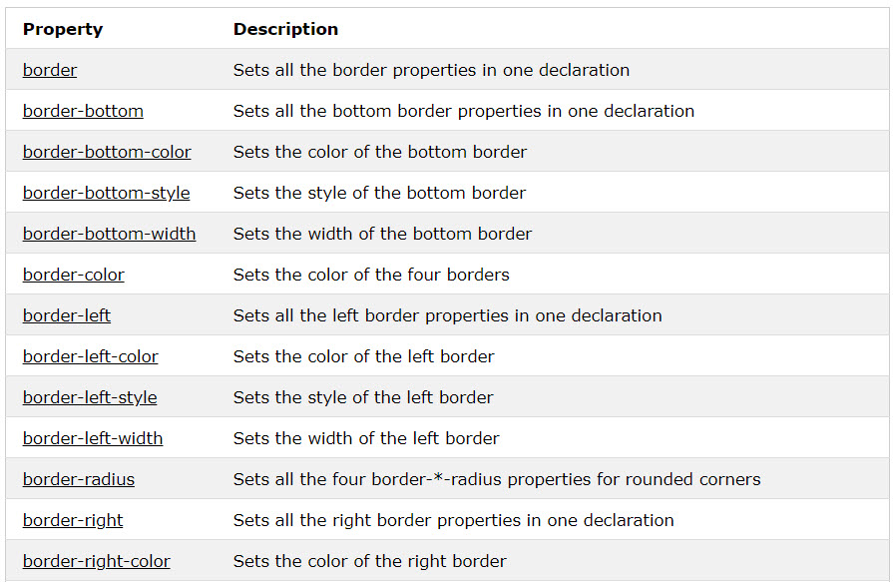
CSS Border
Allow you to specify the style, width, and color of an element's border.
Some border’s properties:

Slide 3
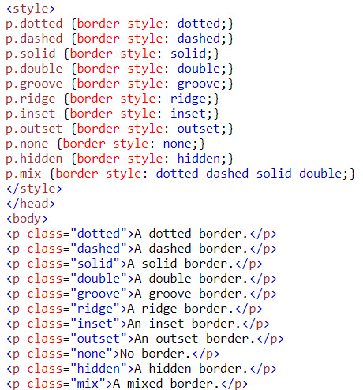
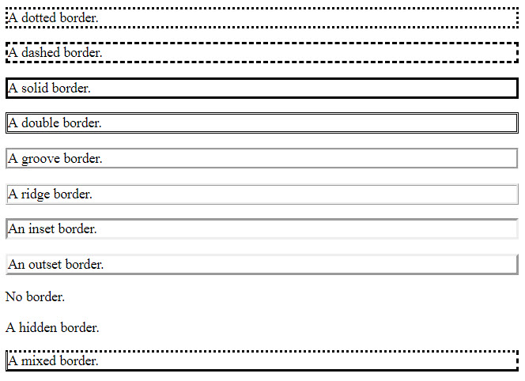
CSS Border
Example:
Result:

Slide 4
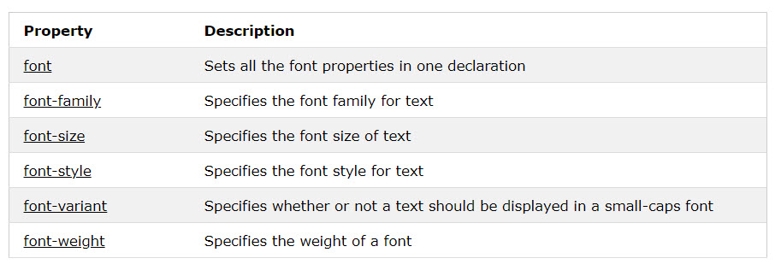
CSS Fonts
Define the font family, boldness, size, and the style of a text.
Some CSS font properties:

Slide 5
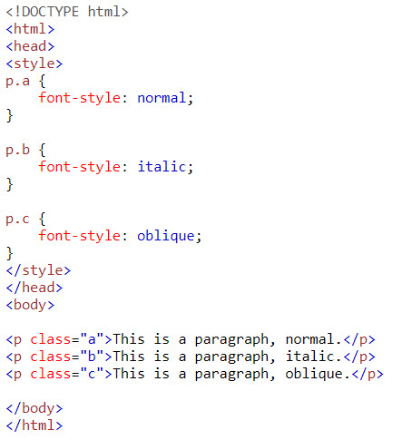
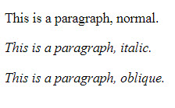
CSS Fonts
Example:
Result:

Slide 6
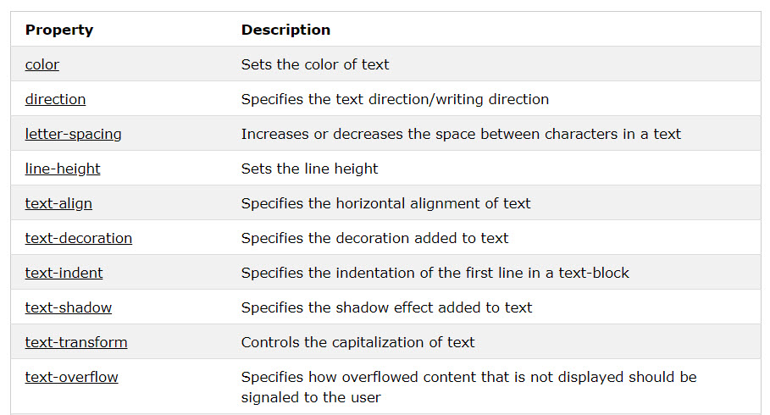
CSS Text
Some CSS Text Properties:

Slide 7
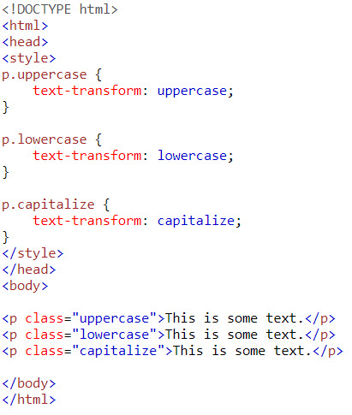
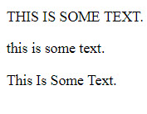
CSS Text
Example:
Result:

Slide 8
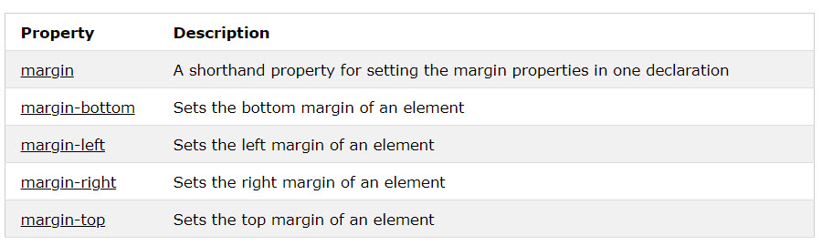
CSS Margins
Are used to create space around elements, outside of any defined borders.
With CSS, you have full control over the margins. There are properties for setting the margin for each side of an element (top, right, bottom, and left).

Slide 9
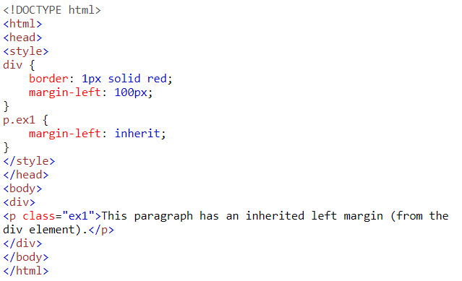

CSS Margin
Example:
Result:

Slide 10
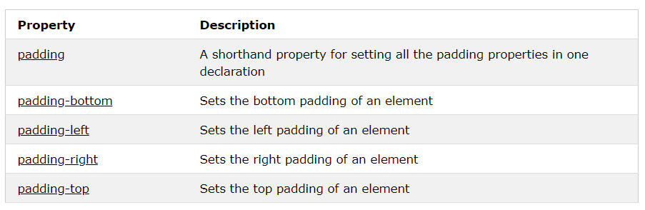
CSS Padding
Are used to generate space around an element's content, inside of any defined borders.
With CSS, you have full control over the padding. There are properties for setting the padding for each side of an element (top, right, bottom, and left).

Slide 11
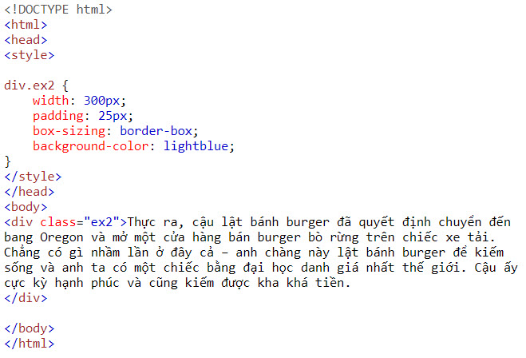
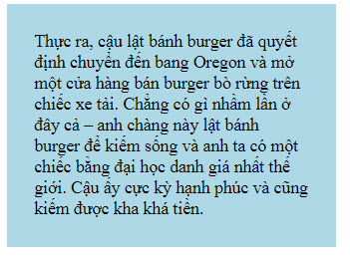
CSS Padding
Example:
Result:

Slide 12
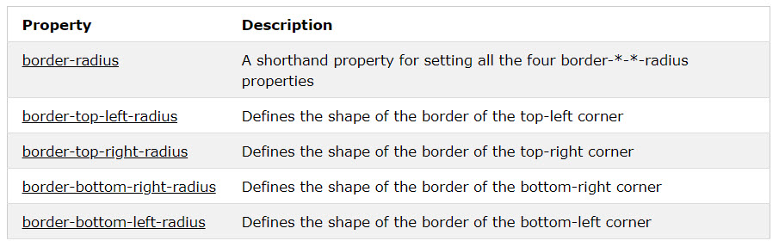
CSS Rounded Corners
CSS Rounded Corners
The CSS border-radius property defines the radius of an element's corners.

Slide 13
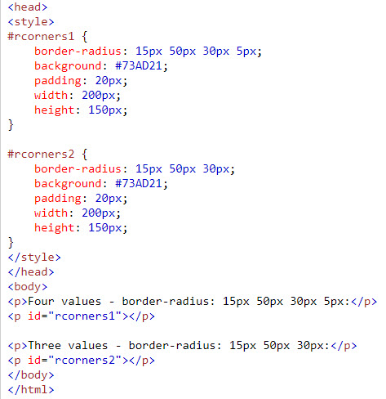
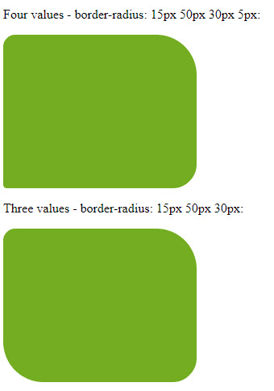
CSS Rounded Corners
Example:
Result:

Slide 14
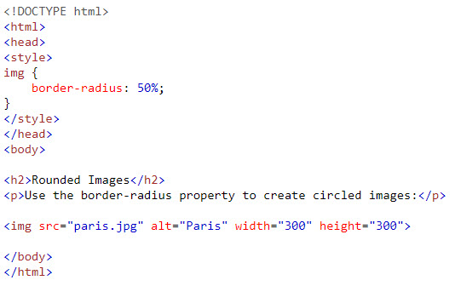
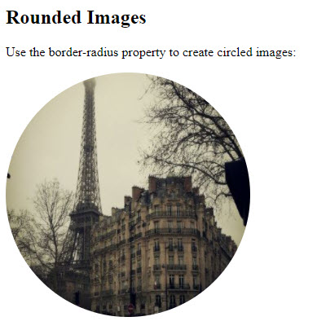
CSS Rounded Corners
Example:
Result:

Slide 15
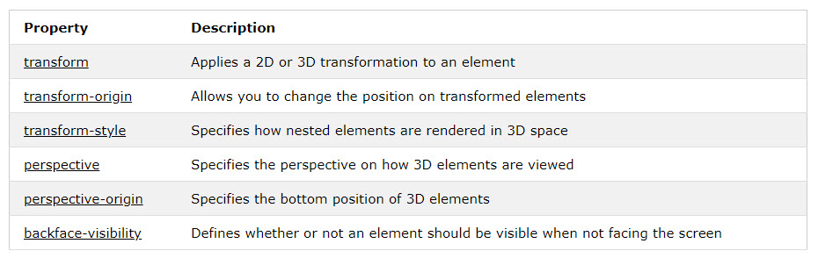
CSS 3D Transforms
CSS allows you to format your elements using 3D transformations.
All 3D transforms properties:

Slide 16
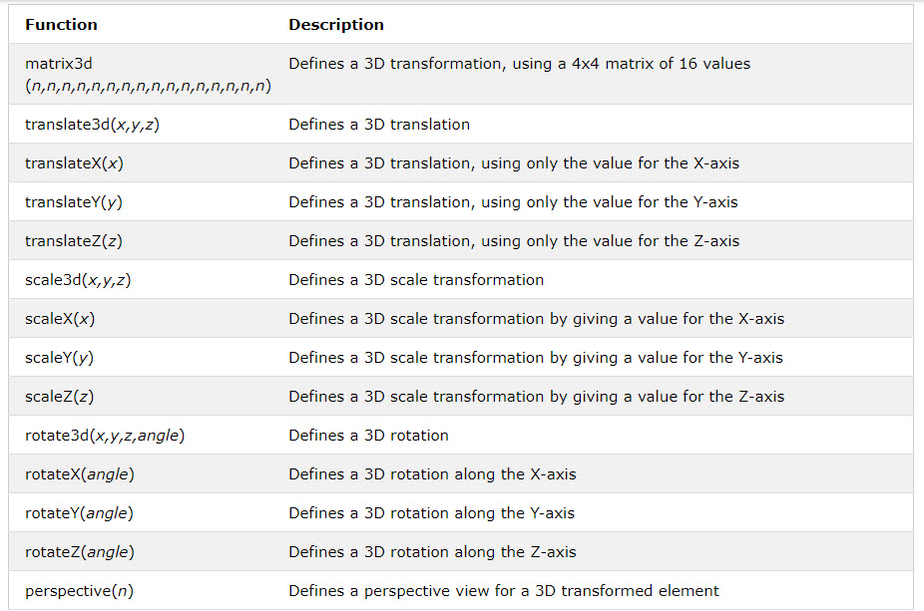
CSS 3D Transforms
3D transforms method:

Slide 17
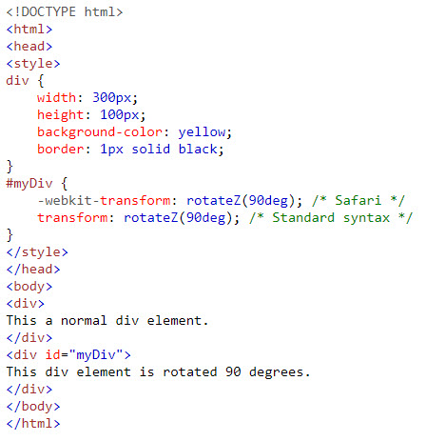
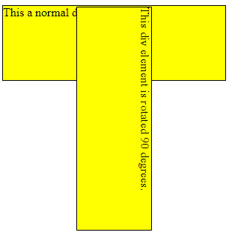
CSS 3D Transforms
Example:
Result:

Slide 18
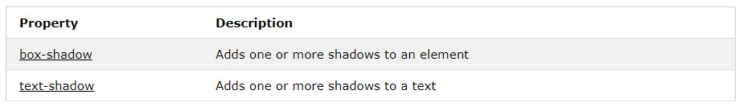
CSS Shadow Effects
With CSS you can add shadow to text and to elements.
CSS shadow properties:

Slide 19
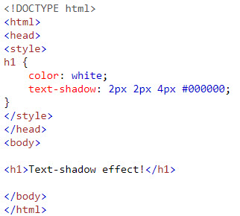

CSS Shadow Effects
Example:
Result:

Slide 20
Positioning HTML Elements
CSS positioning properties:
Are used to control the placement of elements on a Web page.
Can be classified into the following categories:
position
float
The position property is used to position an element on a Web page using the following positioning methods:
Static
Fixed
Relative
Absolute
Notes:
Static positioned elements are not affected by the top, bottom, left, and right properties.
An element with position: relative; is positioned relative to its normal position.
An element with position: fixed; is positioned relative to the viewport, which means it always stays in the same place even if the page is scrolled. The top, right, bottom, and left properties are used to position the element.
An element with position: absolute; is positioned relative to the nearest positioned ancestor (instead of positioned relative to the viewport, like fixed).

Slide 21
Positioning HTML Elements (Contd.)
The float property:
Is used to place HTML elements to the left or right margin, in relation to other elements.
Allows you to wrap the HTML elements around the floated element.
Can be specified by using the following syntax:
float: left|right|none
The following embedded Notepad file contains the code to show the use of float property:

Slide 22

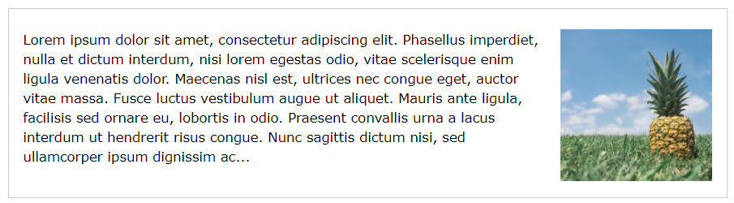
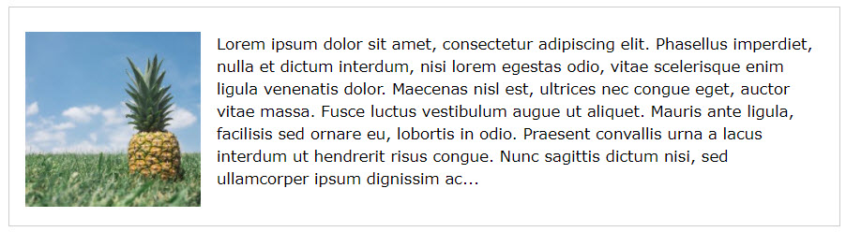

Positioning HTML Elements (Contd.)

Slide 23
Positioning HTML Elements (Contd.)
The clear property:
Is used to turn off the float effect on HTML elements.
Can be specified by using the following syntax:
clear: both|left|right;
The following embedded Notepad file contains the code to show the use of clear
property:

Slide 24
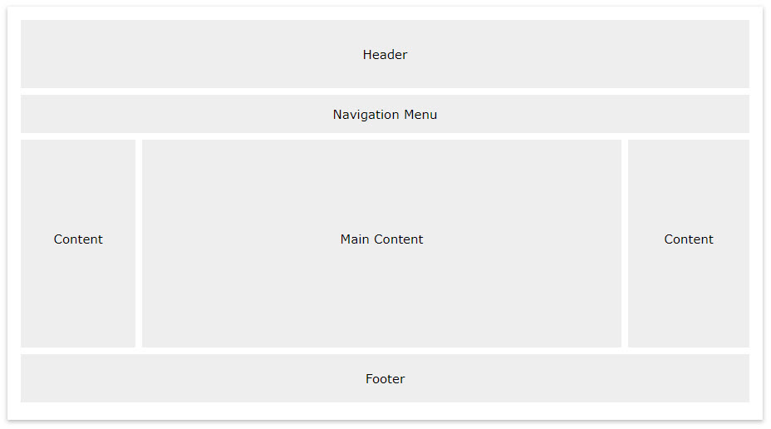
Layout
A typical layout of a website

Slide 25
Layout
Demo designing layout web page by using CSS

Slide 26
Summary
Advanced properties of CSS
Properties of CSS3
Designing layout of website

